Slide 1
Practice 6
Window Program Design

Slide 2
Practice 6 - 1
Metronome

Slide 3
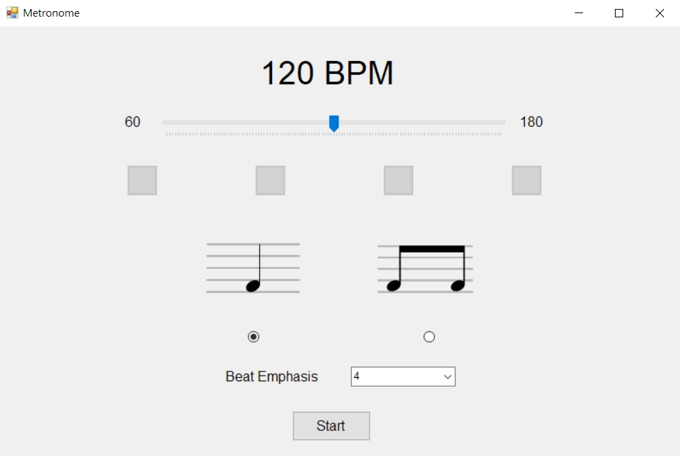
Metronome

Slide 4
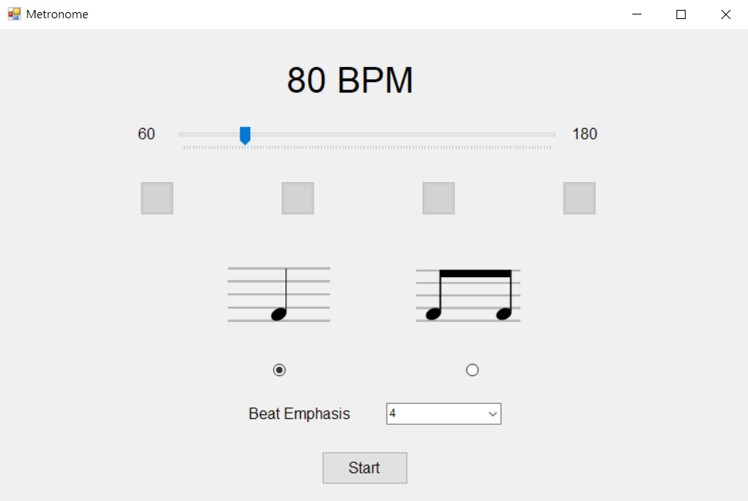
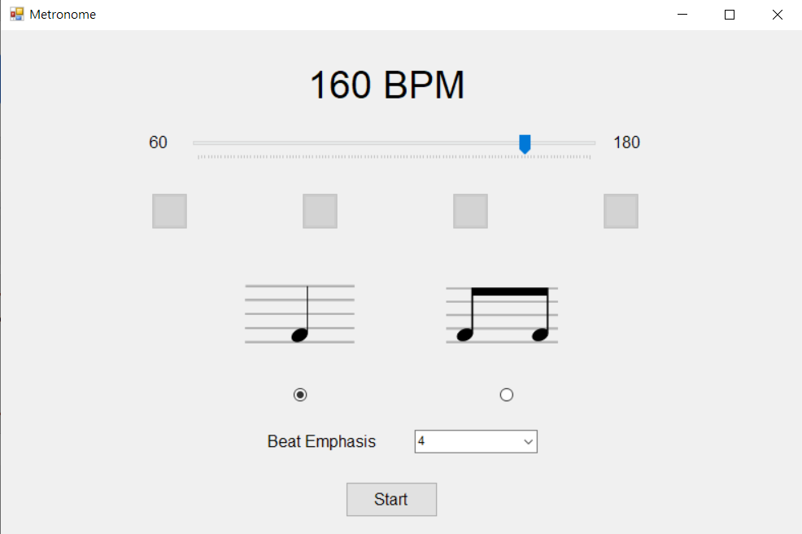
BPM (beats per minute)
BPM means how many beats per minute
Adjust Tracker Bar through BPM
The text above must be linked with the Tracker Bar
The range of BPM is 60~180
Default BPM is 120

Slide 5
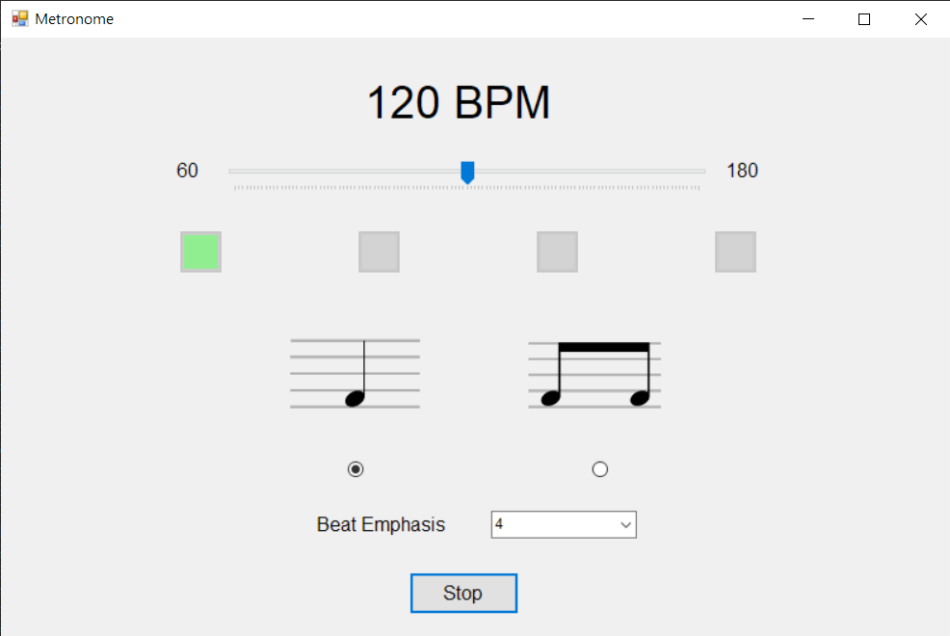
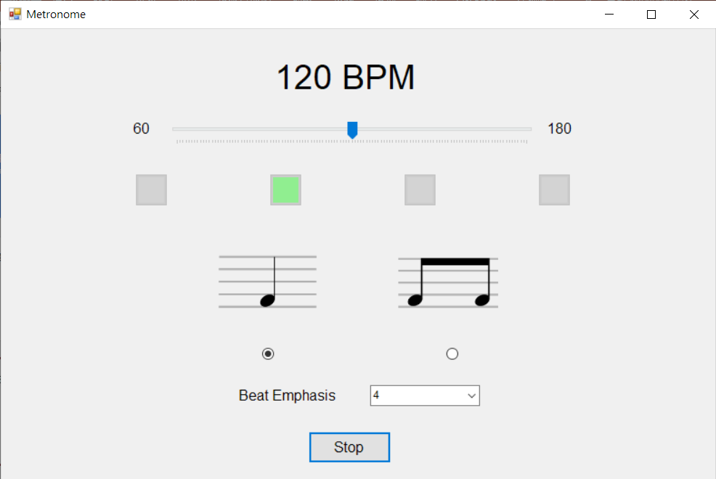
Light Up
Light up when a beat sounds
Light off before the next beat sounds

Slide 6
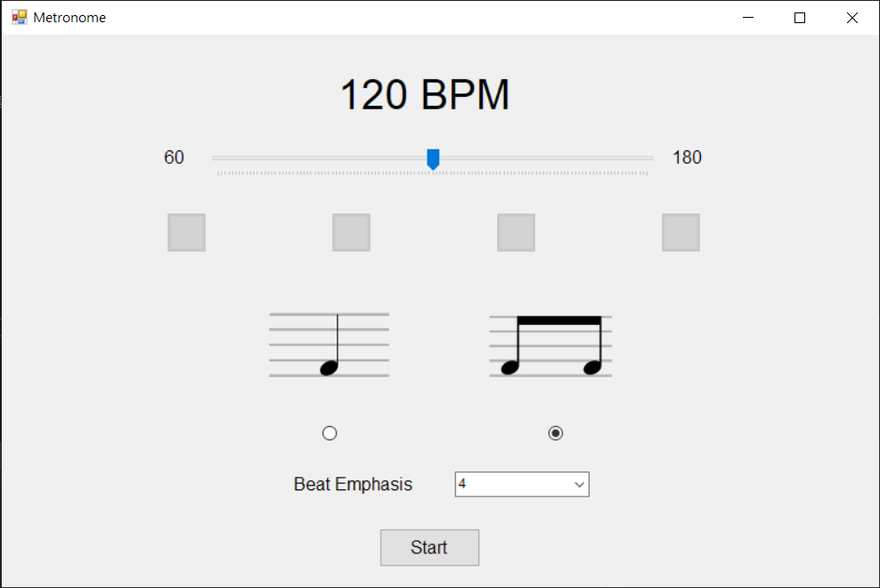
Beat
Divided into two modes: one beat one tone and one beat two tones
You can search for the image on your own or have the TA provide one
Notes can be selected (cannot be selected at the same time)
The default is one beat one tone (left)
One beat one tone
The first beat must sound different from others
One beat two tones
The second tone must sound different from others

Slide 7
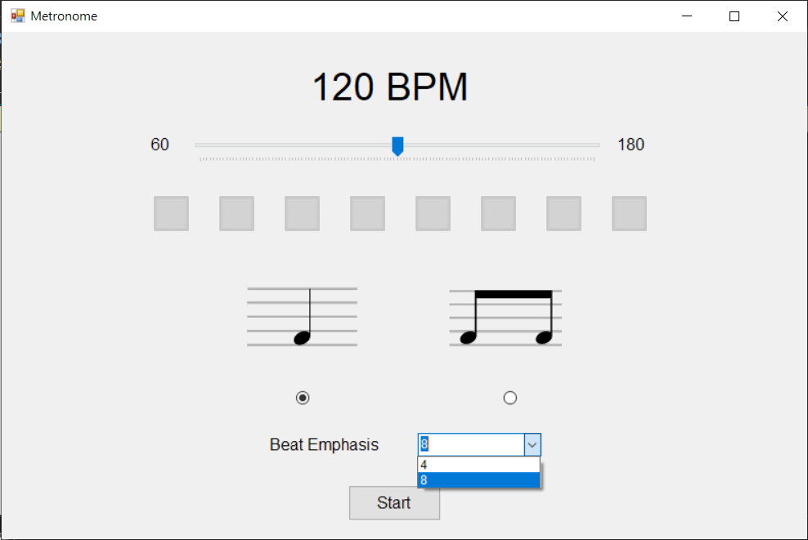
Repeated Tone
Divided into 4 beats and 8 beats
Must show the corresponding number of lights
The default is 4 beats (must show 4)
4 beats
4 beats for a cycle
1 heavy 3 light
8 beats
8 beats a cycle
1 heavy 7 light

Slide 8

Start/Stop
Click “start” to play the sound
The text changes to ”stop”
Click “stop” to stop playing the sound
The text changes to “start”
The light must not be off
After starting, settings could be made

Slide 9
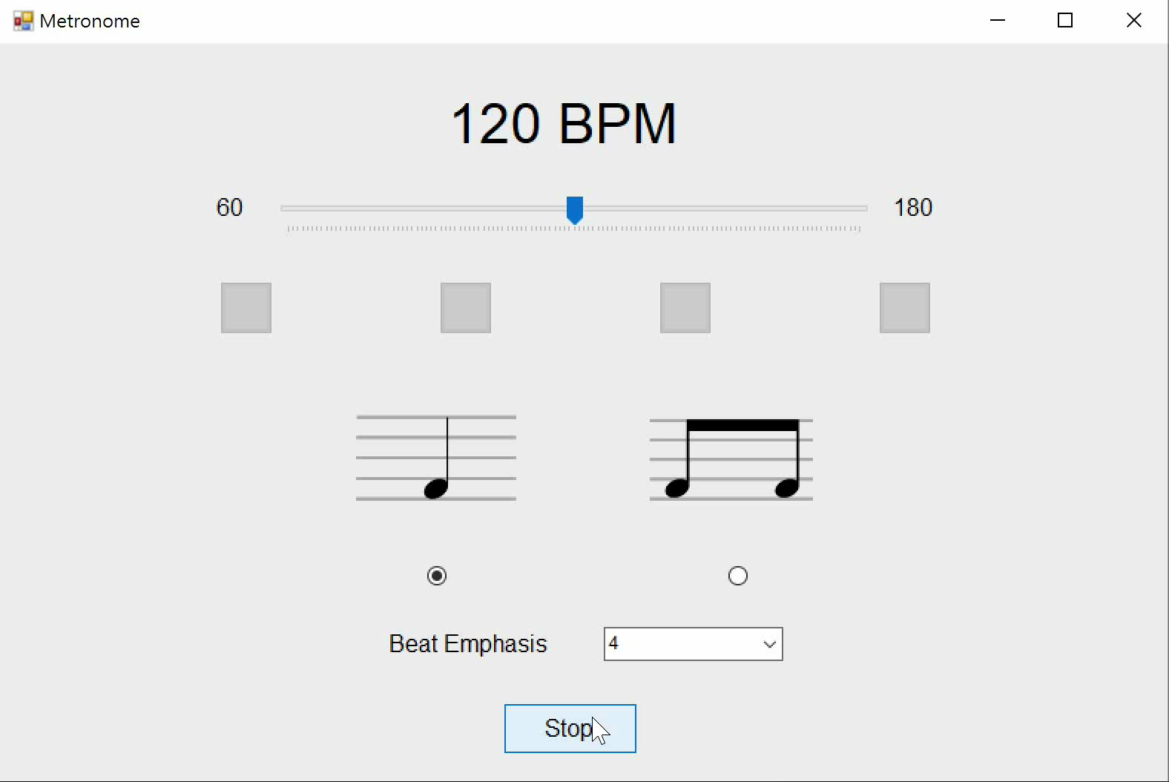
Reveal

Slide 10
Practice 6 - 2
Phone

Slide 11
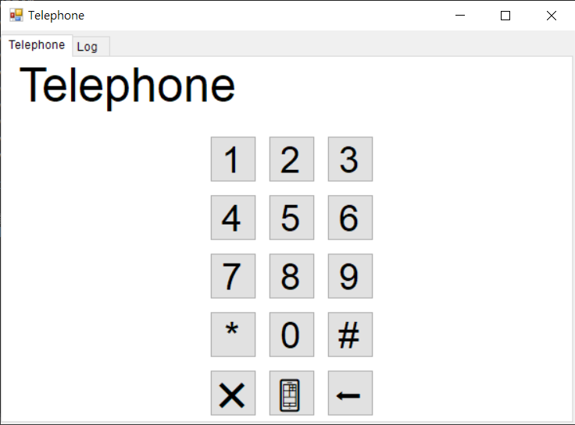
Phone

Slide 12
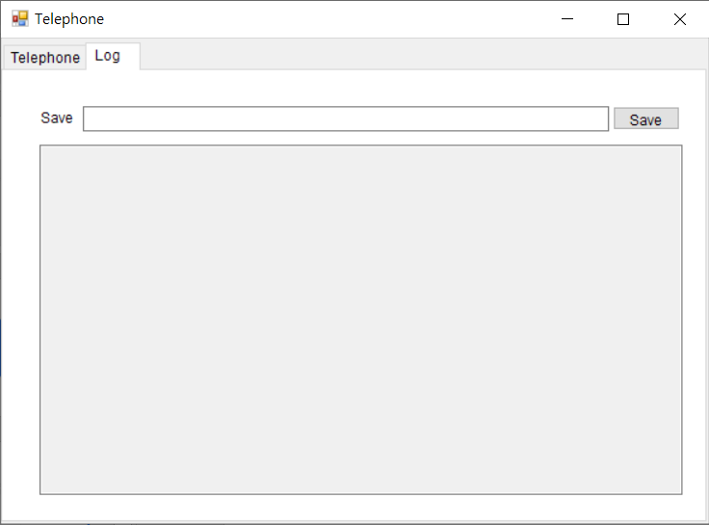
Pagination
Has the pagination of phone and call history

Slide 13
Phone
Number display
The default text is “Telephone”
Number key
Star key
Pound key
Cancel key (bottom left)
Dial key (bottom middle)
Correction key (bottom right)
取消
修正
cancel
correction
撥號
dial

Slide 14
Dual-Tone Multi-Frequency(DTMF)
 | 1209Hz | 1336Hz | 1477Hz
697Hz | 1 | 2 | 3
770Hz | 4 | 5 | 6
852Hz | 7 | 8 | 9
941Hz | * | 0 | #
Dual-Tone Multi-Frequency
A signaling between a telephone and a switch
The keys consist of high frequency and low frequency sine waves
Frequency combination is shown on the right
The audio file is provided by the TA (you can also find it by yourself)

Slide 15
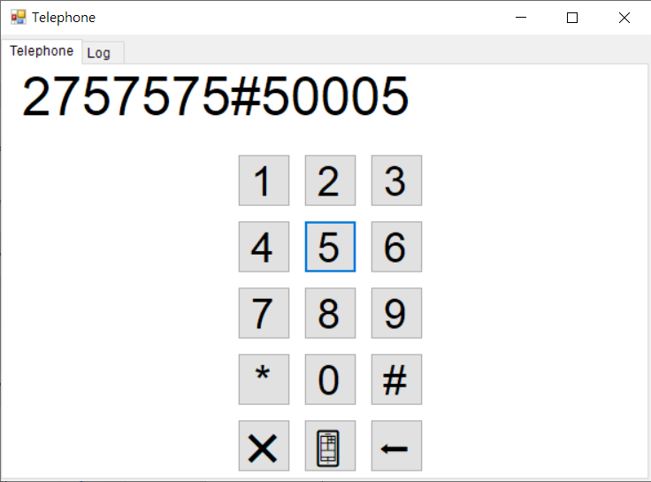
Number Key/Star Key/Pound Key
Clicking the keys above must be shown in the display
Click to play the frequency of the DTMF signal
Play two audio files at the same time
Release the mouse to stop playing
Hint
Create two Windows Media Player elements
Set them invisible
MouseDown, MouseUp

Slide 16
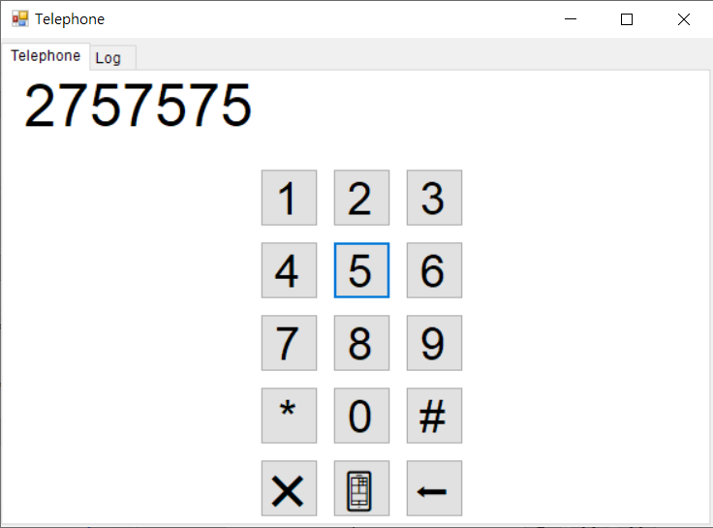
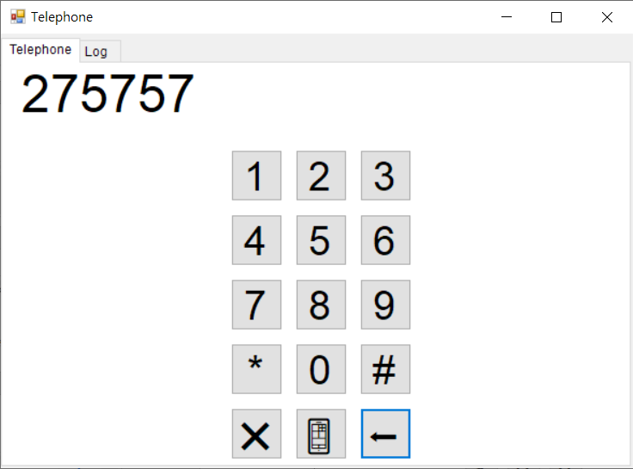
Correction Key
Image could be designed on your own（⬅️）
After clicking, delete one character
Don’t delete if it’s “Telephone”
按

Slide 17
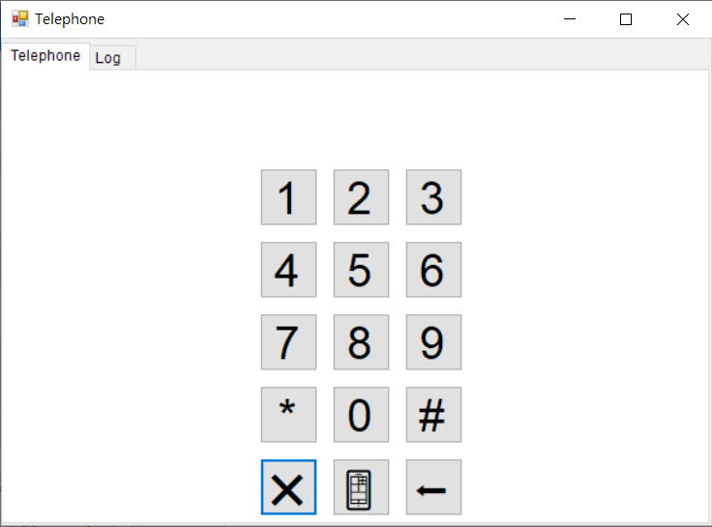
Cancel Key
Image could be designed on your own (❌)
After clicking, the number display area should be cleared
“Telephone” must be cleared as well
按

Slide 18
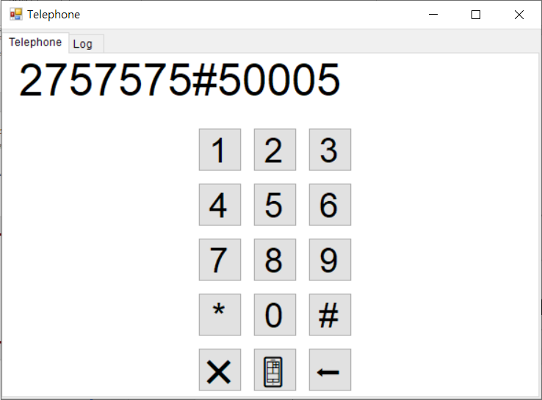
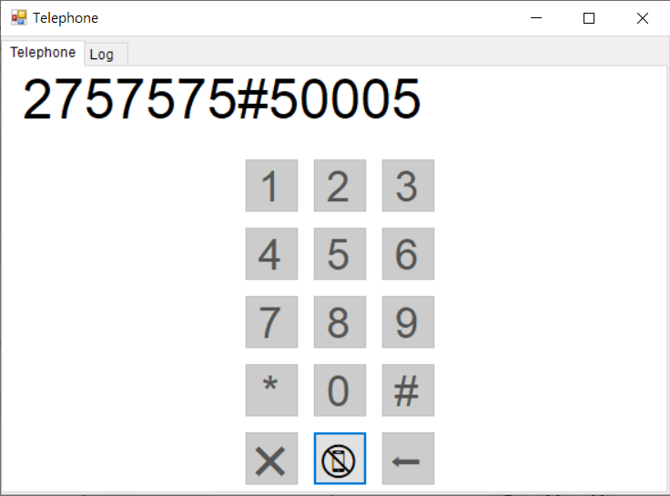
Dial Key
Image could be designed on your own (📱)
After clicking, other keys should be disabled
After clicking, the image should be changed (📵)
按

Slide 19
Dial Key
After dialing, clicking the dial key again should return to the initial state
Display area and Button image should be recovered
Save the phone dialed
按

Slide 20
Keyboard Event
Long pressing the keypad will only show a character
After clicking, the functions are same as what was mentioned above
Play audio
Show in the display area
Only releasing the keypad could stop playing
No need to consider occasions of clicking two number keys at the same time
Key | Actual keyboard
Number key | Number key
Star key | Shift+8
Pound key | Shift+3
Correction key | Backspace
Cancel key | None
Dial key | Enter

Slide 21
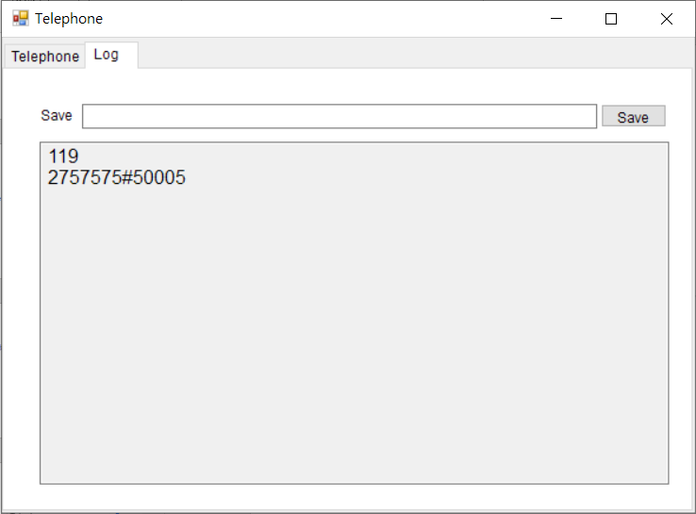
Call History
Mush show numbered called
Numbers that called more recently are below those earlier
No audio is allowed when entering the file name
Hint
tabControl.SelectedIndex

Slide 22
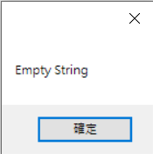
Save Phone History
Clicking Save could save the phone history
If the file name is left blank, the Message Box should pop up
按

Slide 23
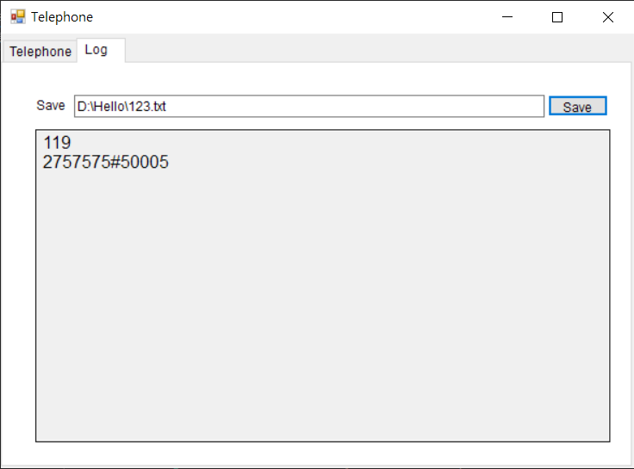
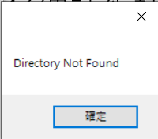
Save Phone History
If the path doesn’t exist, a Message Box should pop up
按

Slide 24
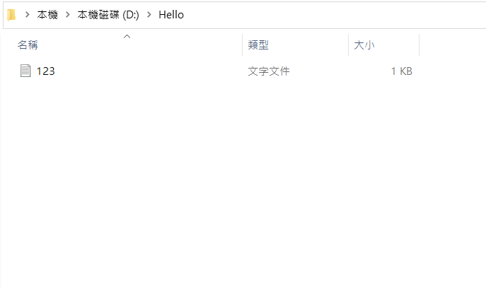
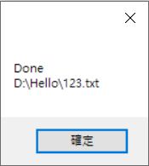
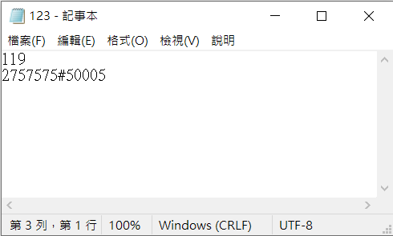
Save Phone History
If saved successfully, it should show the “absolute path”
Hint
fileInfo.FullName
按

